Slide 1

arkNow

Slide 2


Requirements
As an occasional city visitor, I want the app to provide accurate directions to available parking spots so that I can navigate efficiently since I’m not familiar with the streets.
As an electric vehicle driver, I want the app to allow me to filter parking spots near EV charging stations so I can charge my car while I’m away.
As a commuter using public transit, I want to know parking availability near transit stations so that I may easily integrate my various forms of transportation.
As an adult having a family and kids, I want the app to provide information on parking spot sizes to ensure they can accommodate my minivan sized vehicle.
As a bicyclist, I want to identify secure bike parking options so that my bike is safe while I'm away.

Slide 3

Persona
"Finding a parking spot shouldn't be as complex as my day job. I need quick, reliable parking so I can focus on what truly matters”
Quote
Bio
Profile
As a clinical therapist, Julianna's workday in Irving Park requires flexibility and mobility. Her minivan is her trusty companion, but it's not just about size-it's about finding a secure spot swiftly to stay on schedule.
Name:
Age:
Status:
Location:
Occupation:
Vehicle:
Julianna Nevarez
34
In a Relationship
Irving Park, Illinois
Clinical Therapist
Toyota Sienna
Goals
* To identify parking options that are secure, accessible, and tailored to her schedule.
* To leverage an app that simplifies her search with real-time availability for any vehicle size.
* To ensure her focus remains on her clients, not the hunt for parking.
Personality
Safety-conscious
Current Challenges
Extrovert
Currently uses SpotHero but finds it challenging to navigate through it. She seeks an app that not only considers her vehicle's dimensions but also integrates seamlessly into her fast-paced lifestyle.
Urban Navigation
Independent

Slide 4
Persona
“I need an app that guides me to the nearest available spot with an EV charger – no hassle, just efficiency”
Quote
Bio
Profile
Navigating the urban landscapes, Carson applies his problem-solving skills from the tech world to city driving. He’s often in and out of town for work and fun, always looking for a smart, quick place to park and charge his Tesla.
Name:
Age:
Status:
Location:
Occupation:
Vehicle:
Carson Goodwin
22
Single
Chicago, Illinois
Software Engineer
Tesla Model X
Goals
* To find parking spots that are easy to navigate to, even in unfamiliar parts of the city.
* To easily locate and access parking spots with EV charging stations for his Tesla.
Personality
Current Challenges
Tech-Savvy
Carson often encounters a lack of real-time information on parking availability, especially near EV charging spots and transit hubs, which hinders his ability to plan efficiently. He also seeks a parking solution that's quick to navigate, reflective of his need for swift, user-friendly interactions.
Eco-Conscious
Strategic Thinker
Patience

Slide 5

Scenario 1
Miles Allison, a dedicated urban cyclist in Chicago, embraces the freedom his bicycle provides for both his daily commute and social activities, while navigating concerns about finding secure parking in the city.
On a Friday evening, Miles heads to Nutella Cafe Chicago to meet friends, relying on ParkNow, a community-driven platform for urban cyclists, to locate a secure parking spot near the café. It was a simple process - find the location on ParkNow, note the spot, and then ride there.
Despite initial worries about spot availability, he successfully finds a secure spot recommended by ParkNow, allowing him to enjoy his evening free from concerns about his bike safety.
Returning to his bicycle, still securely parked, Miles is relieved. Just before leaving, he decides to contribute to ParkNow by posting his soon to be unoccupied parking spot. The ParkNow website has proven reliable.

Slide 6
Use Case - Parking Systems
Find
Confirm
Miles (Urban Cyclist)
ParkNow
Report
Search for secure parking and view parking details
Select parking spot availability
Update available parking

Slide 7

Scenario 2
Rosa, a dedicated system administrator for Bank of America, forgot to set her alarm after celebrating her promotion. Rushing to work the next morning, she realized she hadn't reserved parking downtown. With SpotHero prices too high, she turned to ParkNow site on her mobile browser.
Quickly adjusting filters, she found an affordable spot close to her office. Relieved, she parked and made it to her meeting on time. The ParkNow interface was straightforward, showing real-time availability of parking spots, with clear indications of price and location.
ParkNow displayed several affordable options within walking distance to her office. Navigating directly to the chosen lot, she found the ParkNow-listed space waiting for her and secured her car. Thanks to ParkNow, she was able to attend her meeting without further hassle.

Slide 8
Use Case - Parking Systems
Search
Filter
Rosa (System Administrator)
ParkNow
Select and Secure
Search for secure parking
Adjust filters for search
Decide and confirm parking spot

Slide 9
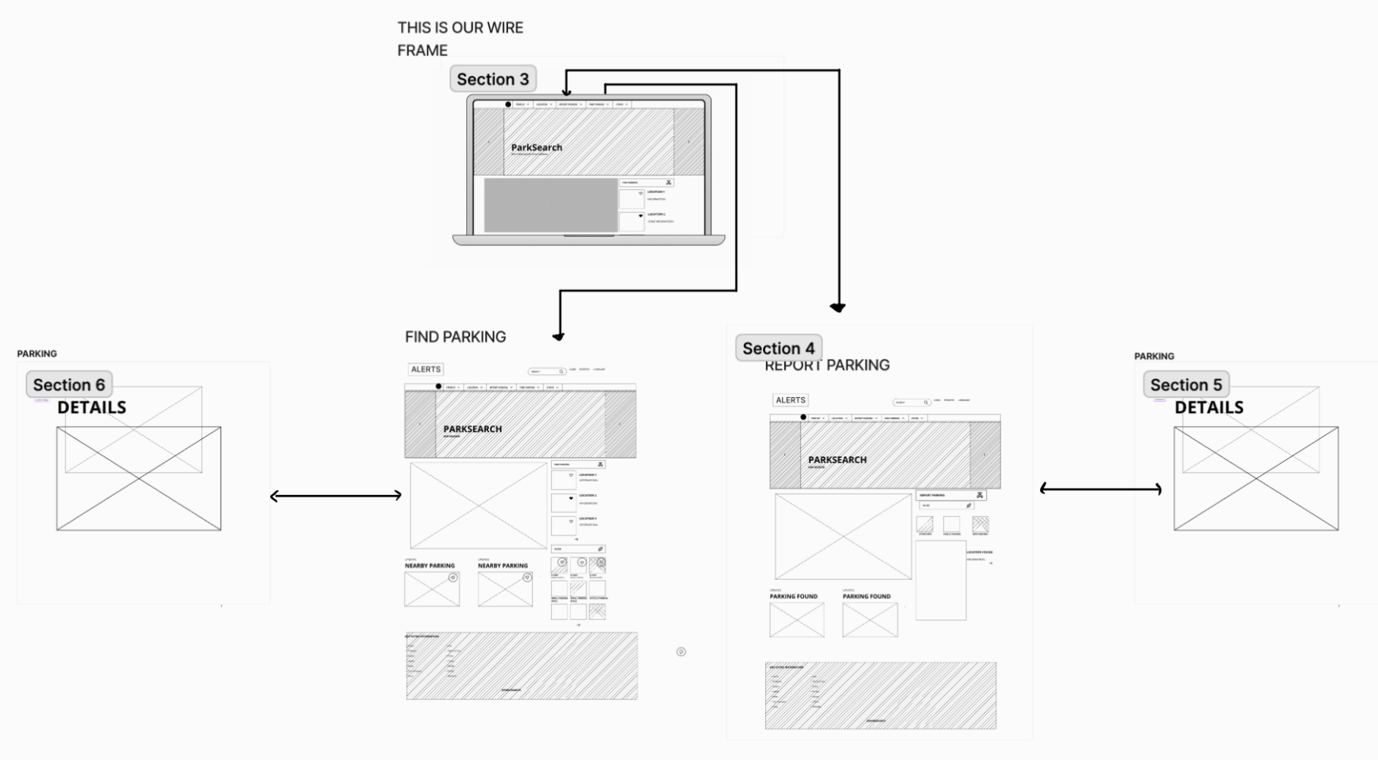
ParkNow Design Implications - Wireframe
There is a main page with tabs across the top to different pages: Profile, Report Parking, Find Parking, and Other
Report Parking takes the user to input a description of available parking for a system update.
Find Parking takes the user to input their preferences and outputs available spaces

Slide 10
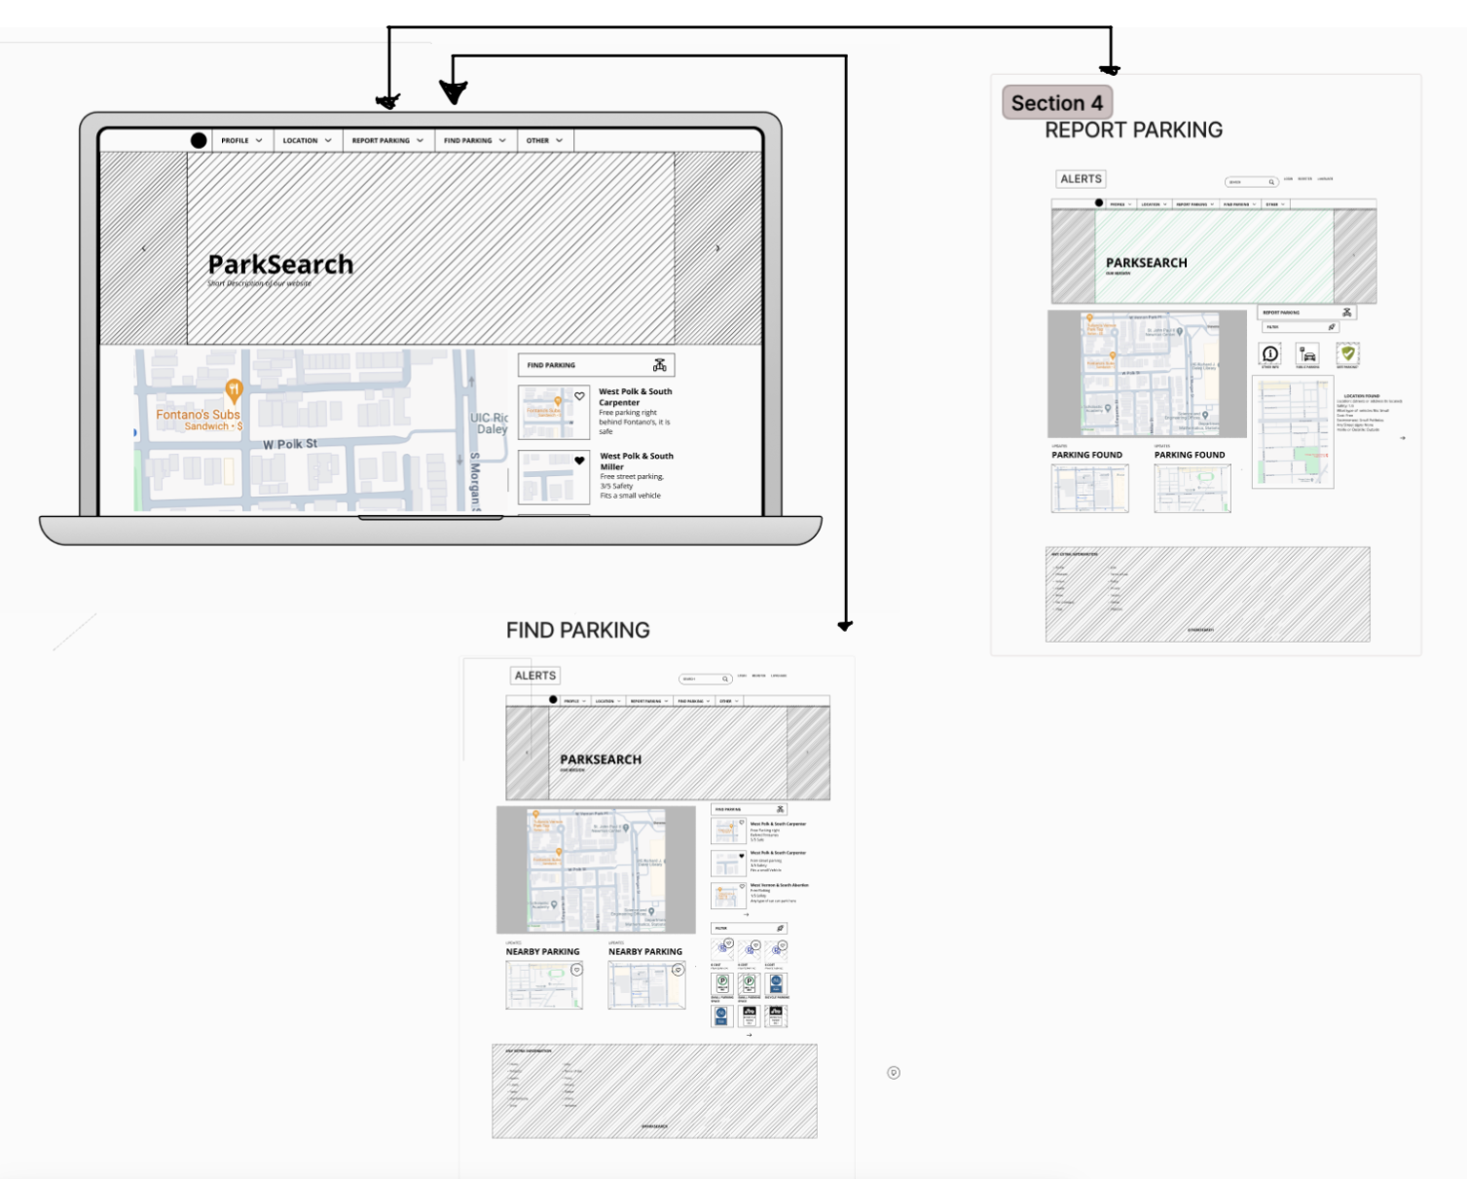
ParkNow Design Implication - Mock Up
Report Parking has a reporting section with a description input for community updates.
Find Parking has list of open parking that is description based and a filtering system with the ability to favorite items.
Both pages have a map API to view the user’s current location and a mapview updates section.

Slide 11

DEMO: Latest Version
You can find the link for the application: https://cs442-parknow.web.app

Slide 12
Design Reflection
Success
Challenges
Implementation of main components
- Report parking
- Find parking
- Filtering Options
Working on the implementation of our maps API

Slide 13
Key Aspects of ParkNow UI Design
Consistency
Navigation
Coherence
Uniformity in design elements such as fonts and colors following the same theme throughout the website
Minimalist interface that presents only essential navigation options to avoid overwhelming users with too many unnecessary elements
Information structured in a logical and coherent way. E.g. Larger portion of the screen allocated to primary component such as the map with pinpoints and reserve a smaller size panel for secondary component such as search results.

Slide 14
Analyzing Functional Prototype
Fulfilled
Accurate map interface displaying available parking spots using separate markers.
Fully operational 'Find Parking' and 'Report Parking' functionalities including confirmation message.
Advanced filters for vehicle type, size, and EV-charging stations are operational and effective
Enhanced navigation across sections, incorporating feedback from User Study 1
Real-time database updates reflect user reports and selections, ensuring current parking information is always available.
Unfulfilled
Clear directions from source to destination
EV charging stations filtering (Although we have the filter, it’s solely from Report Parking & manual searching)
Parking report form and filter options
Proximity
Nearby public transport stations
‘Safety’ - very user specific

Slide 15
Refinement Roadmap
Integrating additional features of Google Maps API to get polyline directions
Unfulfilled
Clear directions from source to destination
EV charging stations filtering (Although we have the filter, it’s solely from Report Parking & manual searching)
Parking report form and filter options
Proximity
Nearby public transport stations
‘Safety’ - very user specific
Integrate an EV charging station API to enhance the map's functionality. The system would cross-checks distances using coordinates and updates parking spots with nearby charging options in real time, improving the EV filter feature.
* Once polyline directions are obtained, proximity can be determined.
* Integrate a Public Transport Stations API onto the map.
* Delving into User Study 2 to understand user perceptions of 'safety' in parking environments.

